Slide 1
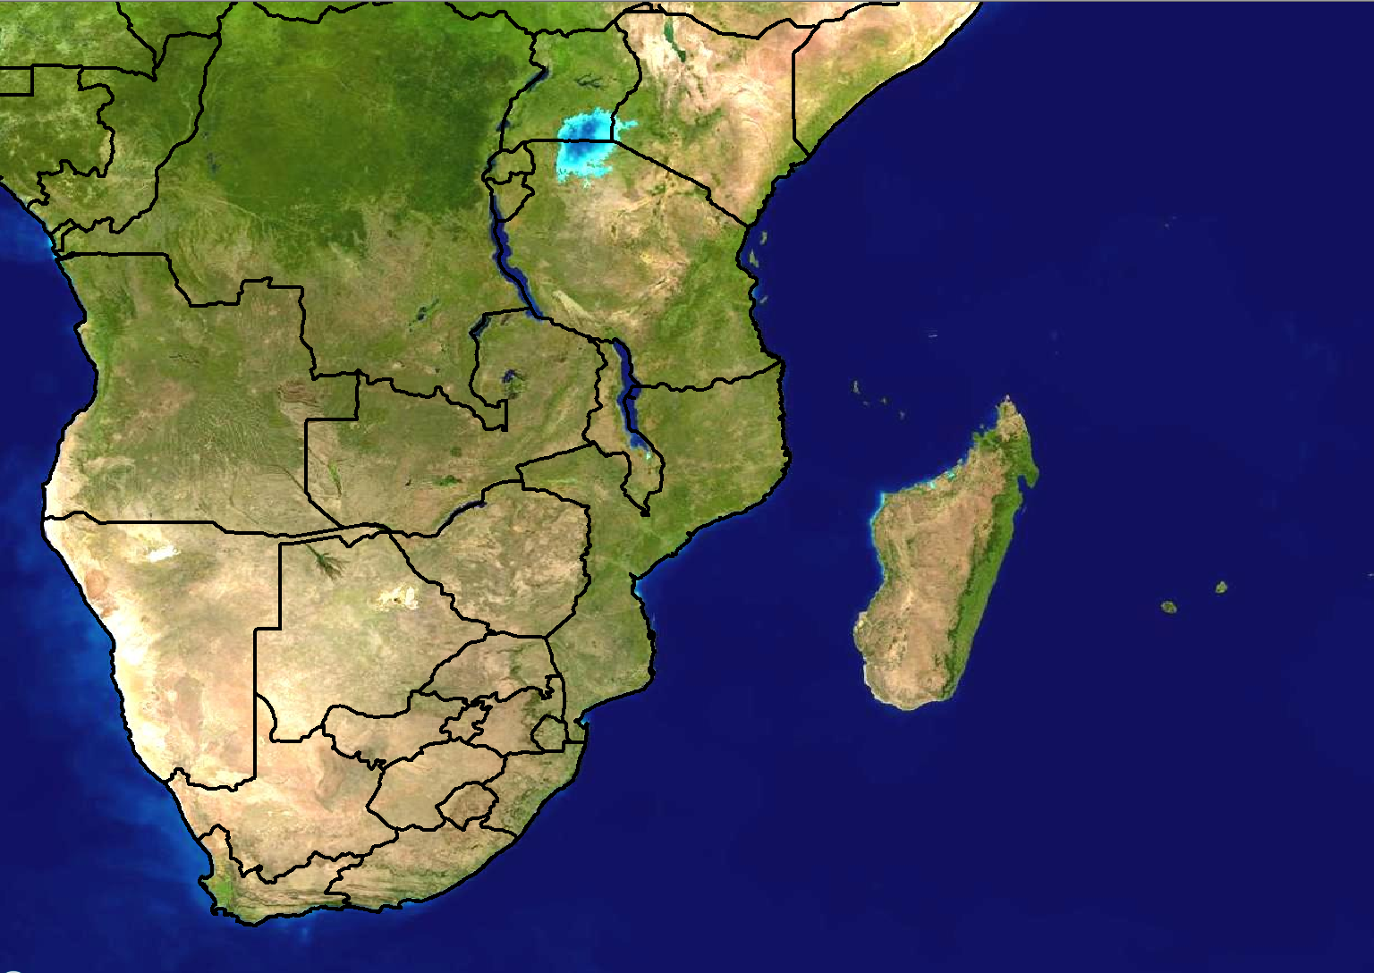
Scenario 1: Forecast for Day 3
24 hour rainfall (mm)
>100
80-100
60-80
40-60
20-40
Forecast issued:
Monday 20 February
Forecast valid:
Wednesday 23 February

Slide 2
Scenario 1 - Additional information:
There is a weak tropical low pressure that is expected to be situated in the southern parts of the Mozambique channel
The exact position and intensity is not very certain at all at the moment as most models are not in agreement.
RSMC La Reunion has sent a bulletin out for the low pressure, but the uncertainty has also been expressed in their discussion and therefore the system has not been named as yet
Models do however show some agreement with regards to large amount of rainfall being expected over the southern parts of Mozambique and possibly 20-40mm over Swaziland. The uncertainty of this rainfall is how far inland it extends. It needs to be kept in mind that if the low intensifies more than expected or if the placement is different, this rainfall area will change significantly

Slide 3
Scenario 2: Forecast for Day 1 (Today)
24 hour rainfall (mm)
>100
80-100
60-80
40-60
20-40
Forecast issued:
Wednesday 23 February Forecast valid:
Wednesday 23 February

Slide 4
Scenario 2 - Additional information:
Tropical low pressure has not intensified much
RSMC La Reunion has sent a bulletin out for the low pressure, classifying it as a tropical depression and giving it the name of ‘Bruno’
Models are in agreement with rainfall amounts of >100mm in 24 hours over the southern parts of Mozambique and Swaziland
The Unified Model (12km) shows 6 hourly rainfall amounts of >150mm between 00-06Z over Mozambique while Aladin shows the same amount of rainfall over that area, but rather for this afternoon (12-18Z)
An MCC moved over Swaziland last night and resulted in high rainfall amounts. Stations over the eastern parts reported rainfall amounts of between 60-80mm in 3 hours.

